Slide 1
PROBLEM STATEMENT 1 SELF CHECKOUT
By Team Strikers,
Bishal Soni
Aayush Soni
Jehan K E

Slide 2
Program Structure
The project is built using Python for the front end and SQL as the backend
The SQL database consists of 4 tables being:
Customer
Inventory
Sales
Stock

Slide 3
Home Page
The Project starts with the Home Page where the user is presented with the options of ‘Retailer’ and ‘Customer’
If a customer/retailer is new they can sign up by entering their details and can then Login

Slide 4
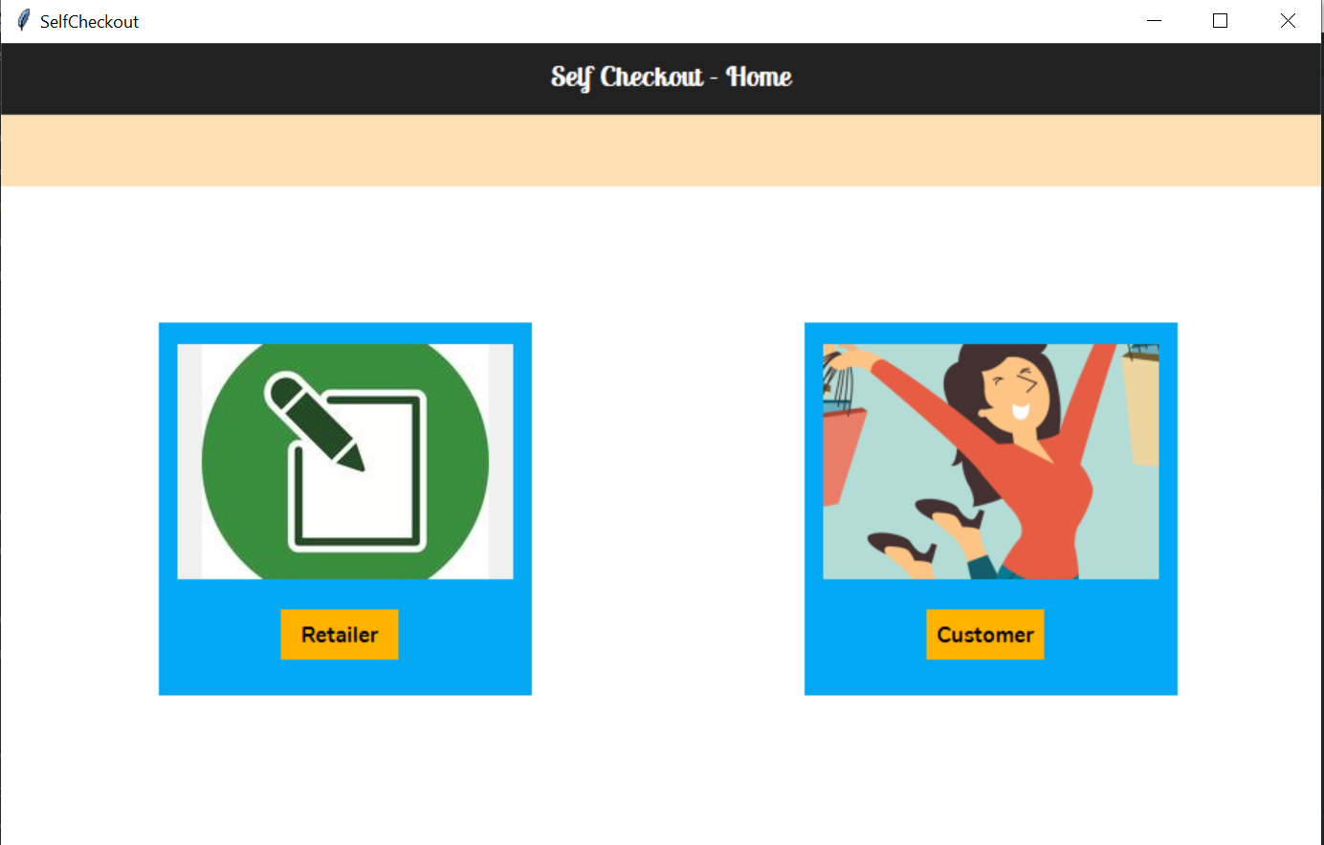

Slide 5
Retailer Page
After logging , the retailer can view all the products along with their price and available quantity
The retailer can:
Add new items
Remove existing items
Update the stock and price of an existing item

Slide 6
Retailer Page
A quick search field is available which helps the user to search for a particular item name
An analysis tab is available where the retailer can analyze his sales and see which products and categories of products are sold most

Slide 7
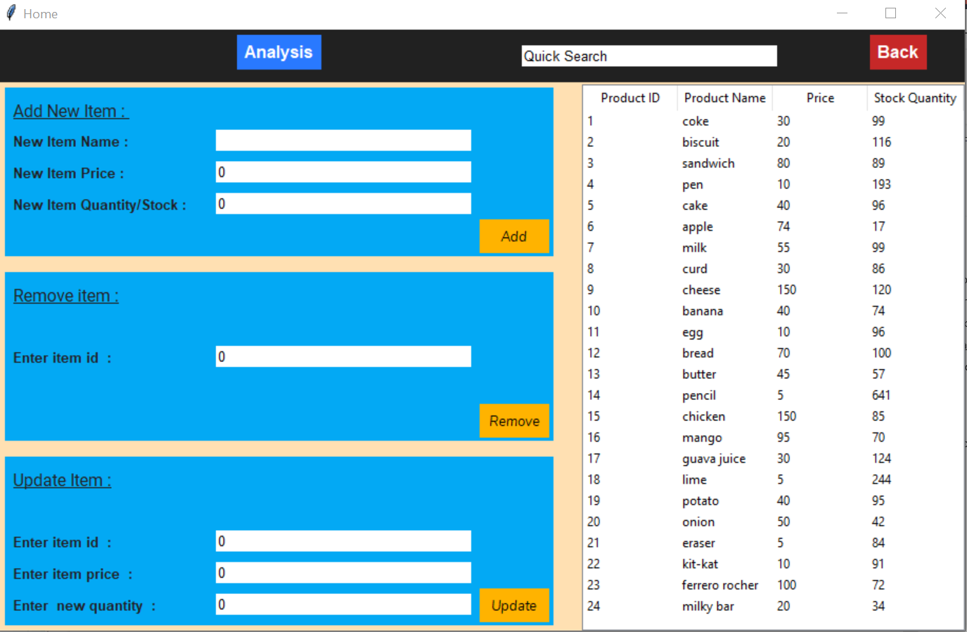

Slide 8
Customer Page
After the customer logs in, they are presented with a window which contains a list of all the products available
From the list user can:
Add products to their list
Remove products
Check bill amount
If a single item is to be added multiple times user just has to press the add button for the number of times

Slide 9
Customer Page
A search bar is available where the user can search for a specific
An ‘Analysis’ section is available for each customer, which shows the customer his spending and trends
To buy the selected list of products user needs to press the ‘Submit’ button
It will take to the billing page which has the list of products and their price

Slide 10
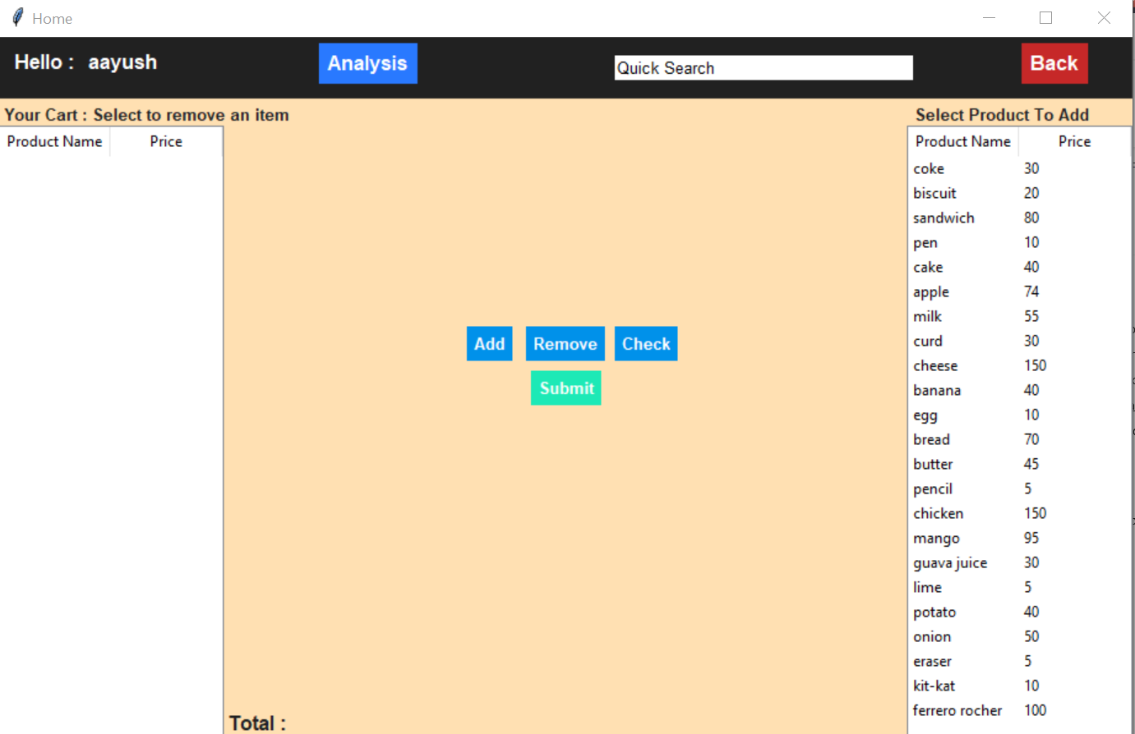

Slide 11
Improvements
Payment methods – Authorizenet API
Recommendations – Pearson Correlation
Shopping route – Prim’s Algorithm

Slide 12
Thank You

